Slide 1


Robert Turner
07-24-2023

Slide 2

Outline
Executive Summary
Introduction
Methodology
Results
Conclusion
Appendix

Slide 3
Executive Summary
Data was gathered from the SpaceX API
Launches from site KSC LC-39A succeeded roughly 77% of the time
Fins and legs on the stage 1 rocket are effective means of aiding the recovery of the 1st stage
Missions targeted at GTO, ISS, LEO, MEO, or PO orbits were less likely to be recovered
Stage 1 recoveries have become more successful over time

Slide 4
Introduction
Many rocket providers are available on the market to launch payloads, but SpaceX typically provides cheaper launches
Unlike the majority of providers, SpaceX is capable of recovery the first stage of the rocket
The first stage accounts for most of the launch work, and each successful recovery cuts down on costs
Not all recoveries are successful
This analysis attempted to determine whether a launch will result in a stage 1 recovery, and what factors influence the recovery

Slide 5

Section 1

Slide 6
Methodology
Executive Summary
Data collection methodology:
Version 4 of the SpaceX API provided data for past rocket launches
Performed data wrangling
Missing data was replaced with the mean of its feature
Performed exploratory data analysis (EDA) using visualization and SQL
Performed interactive visual analytics using Folium and Plotly Dash
Performed predictive analysis using classification models
Used GridCVSearch to estimate optimal parameters for all models
Fit Logistic Regression, Support Vector Machine, Decision Tree Classifier, and K-Nearest Neighbor models to compare efficacy

Slide 7
Data Collection
The SpaceX API was used for all data gathering for past rocket launches
Webscraping of SpaceX's Wikipedia article was completed, but this data was not used in later analysis
Code for all collection and wrangling available on the project GitHub

Slide 8
Data Collection – SpaceX API
Launches/past API used to download primary data table for launches
Rockets, launchpads, payloads, and cores APIs subsequently used to map raw IDs to useful features
Notebook with completed scraping available on GitHub.
Raw rocket data collected through launches/past API, including raw IDs to direct following calls
Rocket IDs used to gather versions info for each booster from rockets API
Launchpad IDs used to gather Launch Site name, latitude, and longitude from launchpads API
Payload IDs used to gather payload weight and targeted orbit from payloads API
Core IDs used to gather specific information for stage 1 rockets from cores API
Leg info, fin info, whether or not the stage had been reused, target landing pad

Slide 9
Data Collection - Scraping
Past launches were scraped from the Falcon 9 and Heavy Launches Wikipedia page
All data in this table is usable without referencing other data sources
Notebook with completed scraping available on GitHub
Scraped past launches from the linked Wikipedia page
Payload mass converted from string, all masses were in KG
Landing status converted to boolean from string
Booster version was reformatted from table string

Slide 10
Data Wrangling
Most data wrangling was performed during collection to map IDs to usable data, and clean up unusual strings
Afterward, outcomes were converted into boolean variables for later model fitting
Any confirmed landing was considered a successful landing, regardless of intended landing destination
Landings that were not reported or confirmed to fail were considered failures
Some payload data was missing; that data was interpolated with the average payload mass
Data wrangling notebook available on GitHub.

Slide 11
EDA with Data Visualization
Flight Number vs. Payload Mass shows the change in payload mass over time
Flight Number vs. Launch Site shows how SpaceX has used each launch site over time
Payload Mass vs. Launch Site shows which launch sites SpaceX uses for heavier / lighter loads
Orbit vs. Success Percentage shows which orbits are most likely to succeed
Flight number vs. Orbit shows the trend in orbit targets over time
Payload Mass vs. Orbit shows which payload weights tend to target each orbit
Year vs. Success Rate shows how recovery success rate has changed over time
All graphs colored with success/failure to show how compared factors impacted recovery success
EDA code available on GitHub

Slide 12
EDA with SQL
Queried for all unique launch site names to list our launch sites
Queried for 5 sample records from launch sites starting with "CCA"
Calculated total payload mass carried by boosters launched from NASA
Displayed the average payload mass carried by a specific booster version for comparison
Listed the date of the first successful recovery
Listed boosters used to carry 4000 – 6000 kg weights
Showed the success rate of missions (ignoring recovery result)
Showed the boosters capable of carrying the largest possible payload
Showed all recovery failures in 2015 and relevant features to those failures
Broke down landing results for landings between 2010 and 2017
SQL Code available on GitHub

Slide 13
Build an Interactive Map with Folium
Created a map with all launch sites and all recovery results from each launch sites
Attempting to see whether specific launch sites have a higher failure rate
Drew distance lines from the CCAFS LC-40 launch site to nearby coastlines, trains, highways, and cities
Illustrated the fact that while launch sites after close to trains and highways for easy component delivery, launch sites also need to be near coastlines and away from cities for safety reasons
Map notebook available on GitHub.

Slide 14
Build a Dashboard with Plotly Dash
Created a dashboard which can view data for all sites or for individual sites
All sites view showed mission frequency for each launch site in a pie chart, and a scatter plot of payload mass against the success or failure of the recovery colored by launch site
Single site view showed frequency of recovery success in a pie chart, and a scatter plot of payload mass against the success or failure of the recovery colored by the booster used
The goal for each graph was the same; we were looking for launch sites which were more prone to recovery failure or a relationship between payload size and failure rate.
Python code available on GitHub.

Slide 15
Predictive Analysis (Classification)
For each model, GridCVSearch was used to select optimal parameters
GridCVSearch used 10-fold cross-validation to test a range of parameters for each model and selected the best
The following classifiers were attempted on this data:
Logistic Regression
Support Vector Machine
Decision Tree Classifier
K-Nearest Neighbors:
Notebook available on GitHub.

Slide 16
Results
Higher weight payloads appear more prone to failure
Orbit targets GTO, ISS, LEO, MEO, PO, and SO are mor prone to failure
The presence of grid fins or legs on the stage 1 rocket increases the odds of recovery
Dashboard shows site CCAFS LC-40 is a heavily used site and prone to failure
Also shows some boosters are not used for higher weight payloads
All models show roughly 85% rate of successful predictions and performed equally well on the test set
False positives were the most likely error made by each model

Slide 17

Section 2

Slide 18
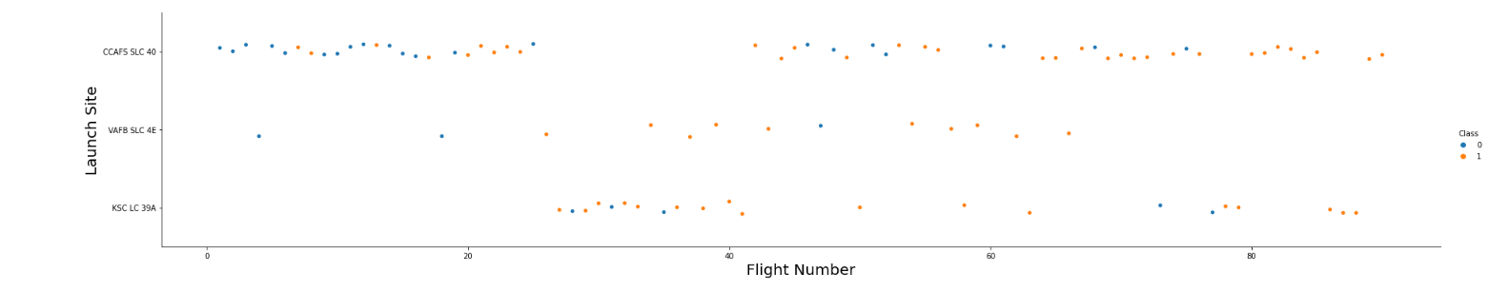
Flight Number vs. Launch Site
The launch site most commonly used by SpaceX varied over time
VAFB SLC 4E produced the highest rate of success, but also was not frequently used
As flight number increased, the recoveries became more successful

Slide 19
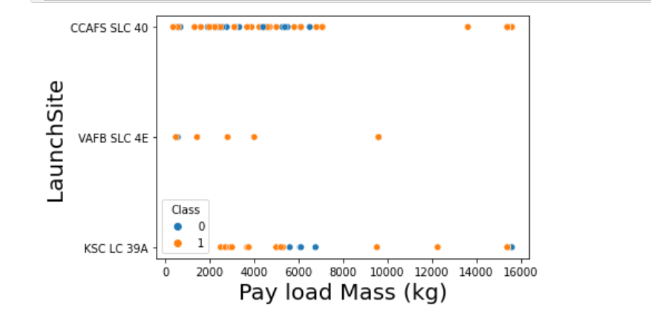
Payload vs. Launch Site
Most launches performed had a payload of less than 10,000 kg
VAFB SLC 4E was primarily used for smaller launches
Larger payloads tend to produce more failures than smaller payloads

Slide 20
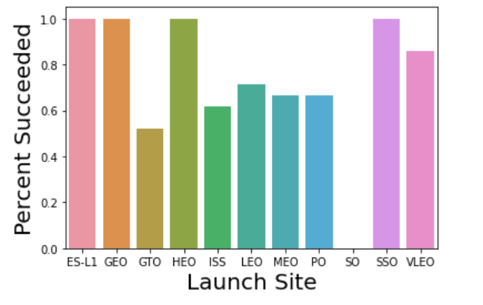
Success Rate vs. Orbit Type
Missions targeted at ES-L1, GEO, HEO, and SSO orbits were always successfully recovered
Missions targeted at GTO, ISS, LEO, MEO, or PO orbits were less likely to be recovered.
No missions targeted at a SO orbit were recovered

Slide 21
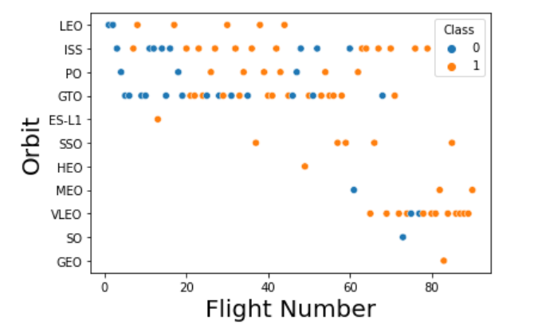
Flight Number vs. Orbit Type
GTO was the most common orbit target that also included a high failure rate
Only 1 orbit was attempted for the SO, ES-L1, or GEO target
The LEO, SSO, and PO targets were commonly used, and had a high success rate

Slide 22
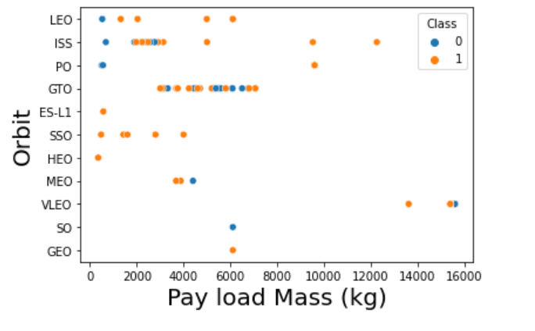
Payload vs. Orbit Type
No payloads heavier than 8,000 kg were sent to LEO, GTO, ES-L1, SSO, HEO, MEO, SO, or GEO orbits
For GTO orbits, payload mass appears to not make a major difference
For ISS orbits, larger payloads were more likely to have a successful stage 1 recovery

Slide 23
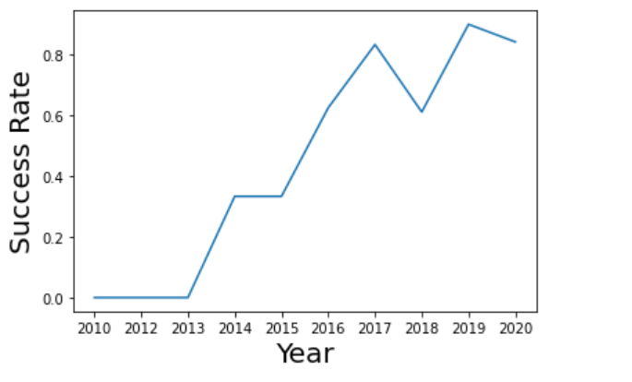
Launch Success Yearly Trend
Since 2013, successful stage 1 recoveries have increased along with the year
In 2018 there was a drop in success rate back to 2016 levels

Slide 24
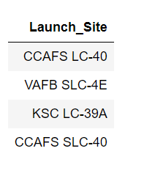
All Launch Site Names
There are only 4 unique launch sites present in this dataset
Launch Sites:
CCAFS LC-40
VAFB SLC-4E
KSC LC-39A
CCAFS SLC-40

Slide 25
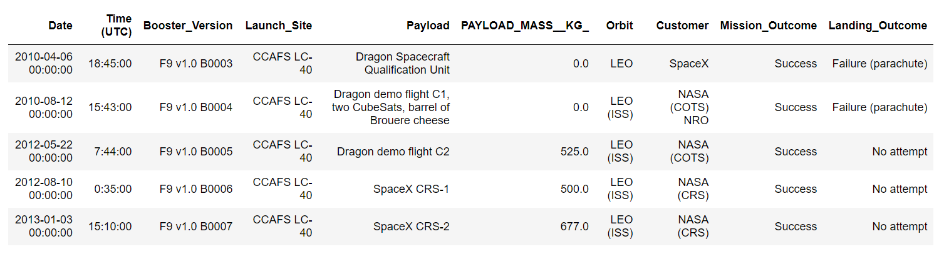
Launch Site Names Begin with 'CCA'
Launches from CCAFS LC-40 were highly varied, as this is a frequently used launch site

Slide 26
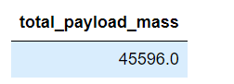
Total Payload Mass
For NASA requested missions, 45,596 kg of payload has been moved by SpaceX
Most of these deliveries likely went to the ISS based on the query from the previous slide

Slide 27
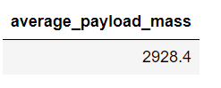
Average Payload Mass by F9 v1.1
The average payload sent with an F9 v1.1 booster was 2928 kg
This visually appears to be roughly average for the entire dataset per our previous graphs.

Slide 28
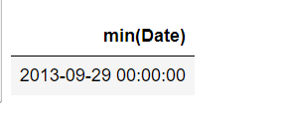
First Successful Ground Landing Date
Prior to September 2013, no attempted stage 1 recoveries were successful

Slide 29
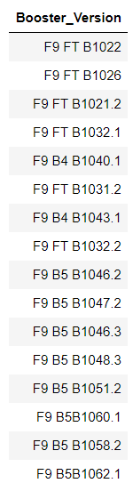
Successful Drone Ship Landing with Payload between 4000 and 6000
Many boosters have experienced a successful landing on a drone ship with average sized payloads

Slide 30
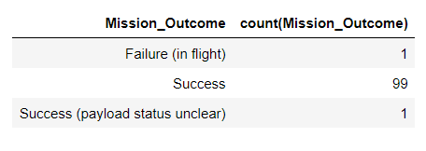
Total Number of Successful and Failure Mission Outcomes
Most SpaceX missions are successful, even if the stage 1 recovery is not
There has only been one SpaceX mission that has ended in failure during the flight

Slide 31
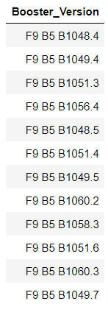
Boosters Carried Maximum Payload
Many versions of boosters have successfully delivered the largest attempted payload from SpaceX
Each of these boosters appears to be part of the B5 series of F9 boosters

Slide 32
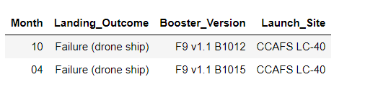
2015 Launch Records
In 2015, only two missions resulted in a failed stage 1 recovery
Both were targeted at drone ship landings
Both used F9 v1.1 rockets, and were launch from CCAFS LC-40

Slide 33
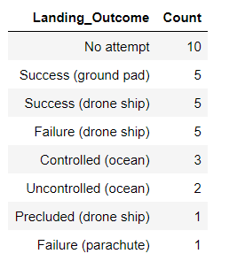
Rank Landing Outcomes Between 2010-06-04 and 2017-03-20
The most likely landing outcome was not attempting to land the stage 1 rocket in the first place
Landings aimed at the ground always succeeded, but were less often attempted
Drone ship landings had a 50% failure rate, and were the most commonly used landing site
Ocean landings were marginally more likely to succeed than fail

Slide 34

Section 3

Slide 35
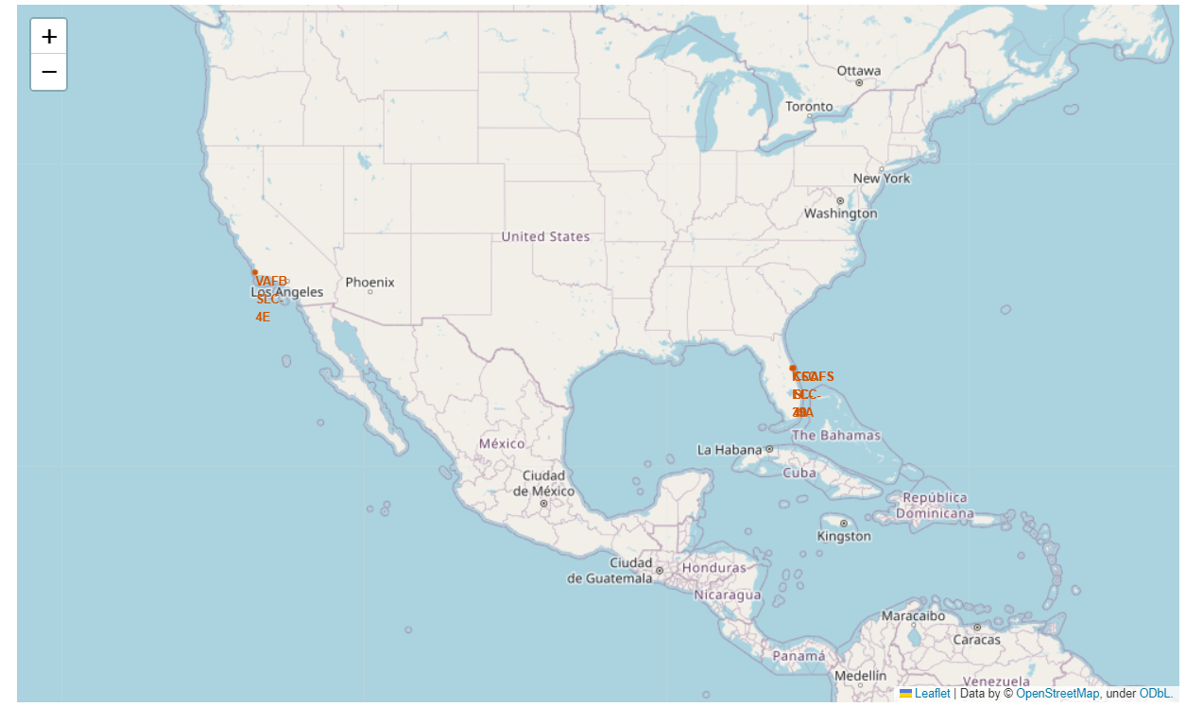
Launch Site Locations
All launch sites are near the equator, and near coastlines
There are no launch sites in middle America
Locations are likely selected to make it easy for failed launches or landings to crash in the ocean safely

Slide 36
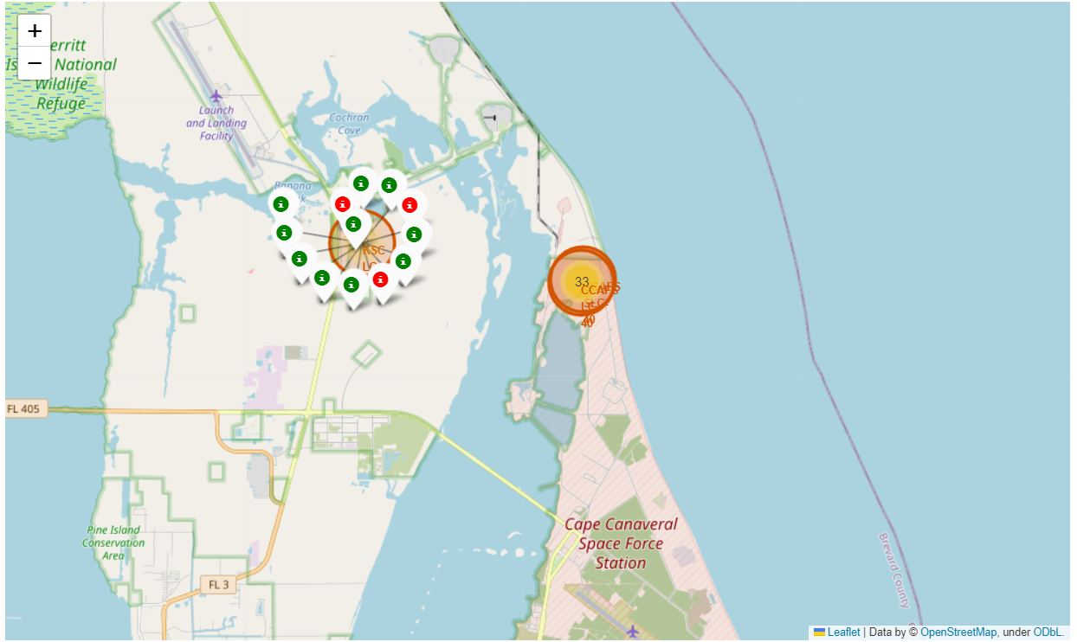
Launch Site Success Breakdown
Most launches are from the launch sites on the east coast
The CCAF launch sites are responsible for more failed recoveries than other sites
The KSC LC-39A launch site has only had 3 failed recoveries across its lifetime

Slide 37
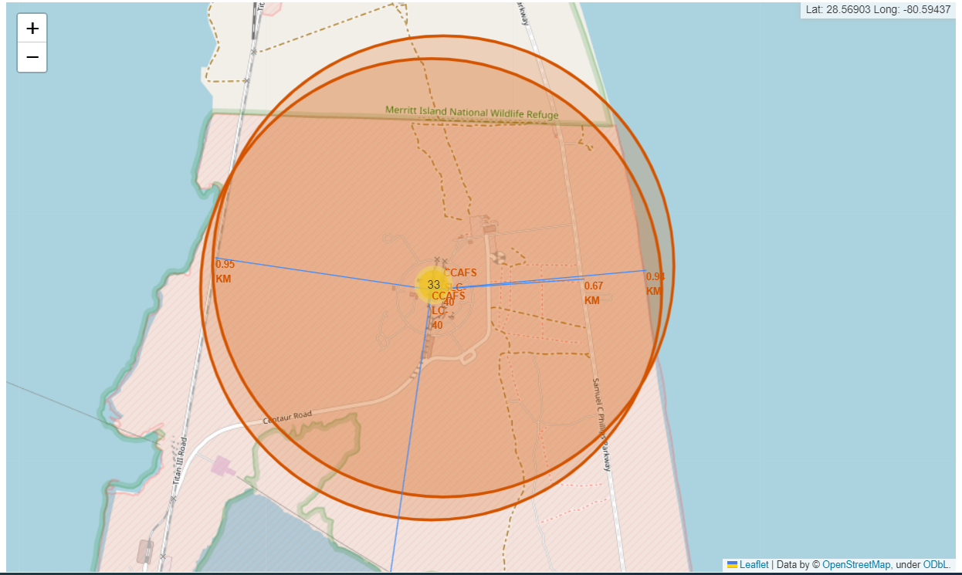
Distances from Important Landmarks
Railways and highways useful for delivering large rocket parts are less than 1 km from the launch site
The coast line is also within 1 km of the launch site to allow for safe crashes
The nearest city, Cape Canaveral is 18 km from the launch site
This supports the conclusion that launch sites need to be easy to reach and close to the ocean, but farther from cities for safety reasons

Slide 38

Section 4

Slide 39
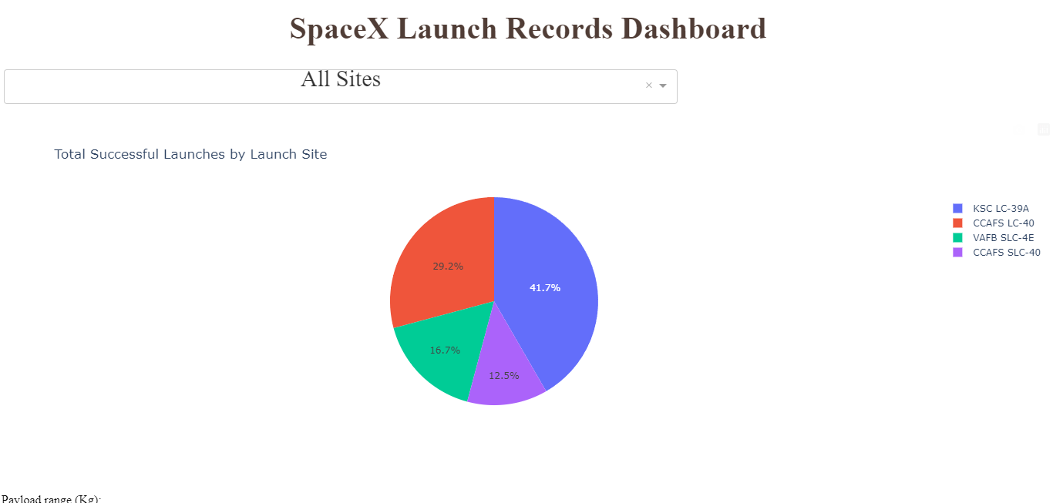
Launch Successes by Launch Site
Most successful recoveries were from the KSC LC-39A launch site
The CCAFS LC-40 launch site is responsible for many of the launches, but contributes few successful recoveries to the total

Slide 40
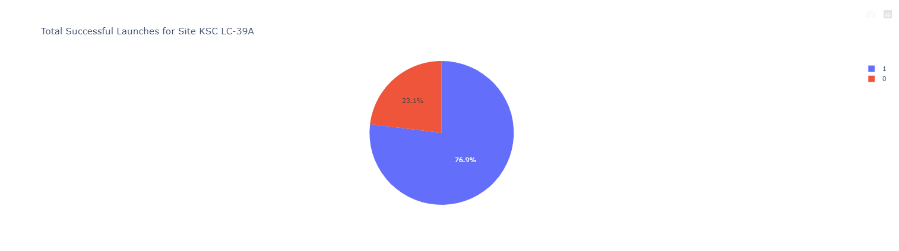
Most Successful Launch Site – KSC LC-39A
KSC LC-39A is the most successful launch site in the dataset
All other launch sites show <50% success rate for recovery

Slide 41
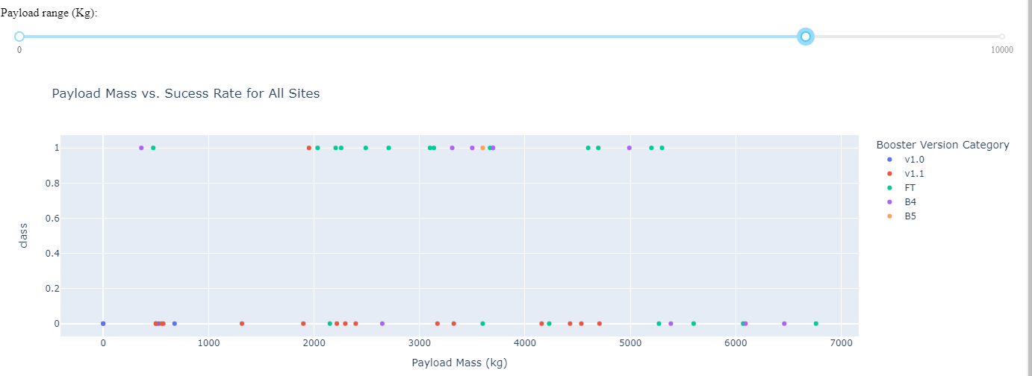
Recovery Success by Payload Mass
The mass of the majority of payloads was under 7000 kg
The smallest and largest payloads failed more often than mid-sized paylods
The FT version booster has a high recovery success rate

Slide 42

Section 5

Slide 43
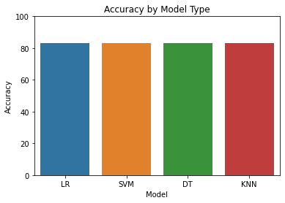
Classification Accuracy
All models have the same measured accuracy in our testing set
Within our training set, each model has roughly an 85% accuracy
The logistic regression model is most effective as it fits quickly and provides probability estimates

Slide 44
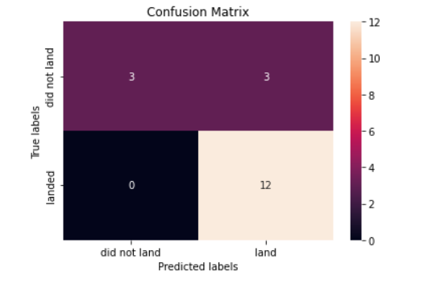
Confusion Matrix
There are no false negatives reported in the testing set for this model
Roughly 50% of the negative recovery outcomes are mislabeled
This model is most accurate when predicting that a launch will fail

Slide 45
Conclusions
Per the logistic regression model coefficients, stage 1 legs and fins are both effective at increasing recovery rate (appendix A)
Most launches from KSC LC-39A include a successful stage 1 recovery
Missions targeted at GTO, ISS, LEO, MEO, or PO orbits were less likely to be recovered.
While we can fairly accurately predict if a recovery will succeed or fail, our model is most accurate at determining that a recovery will fail
Launch sites are placed near coastlines for safe failure as even stage 1 landings we predict to succeed are prone to failure

Slide 46
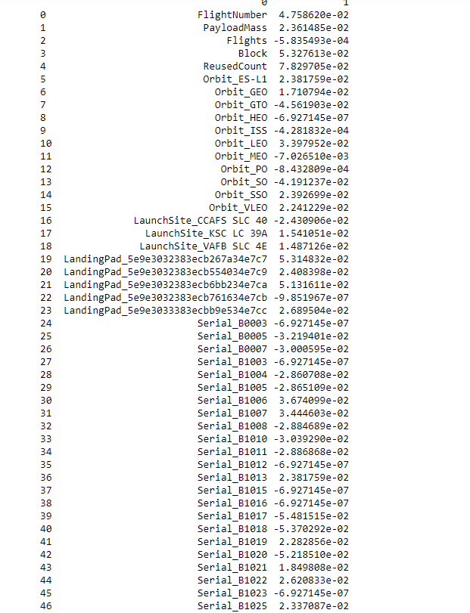
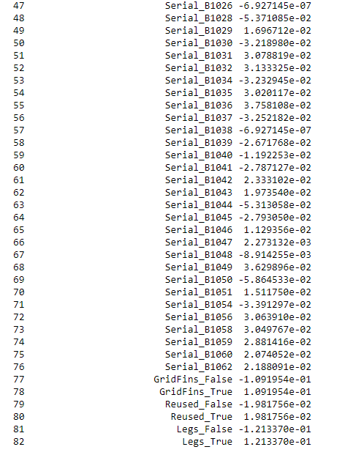
Appendix A – Logistic Regression Coefficients
As all features are scaled to the same range, coefficient magnitudes can be directly compared
The presence of fins or legs provide the largest improvement to recovery success
The improvement of rockets over time is shown by the flight number feature

Slide 47


